Slide 1

Higher Diploma is Computer Science

Slide 2
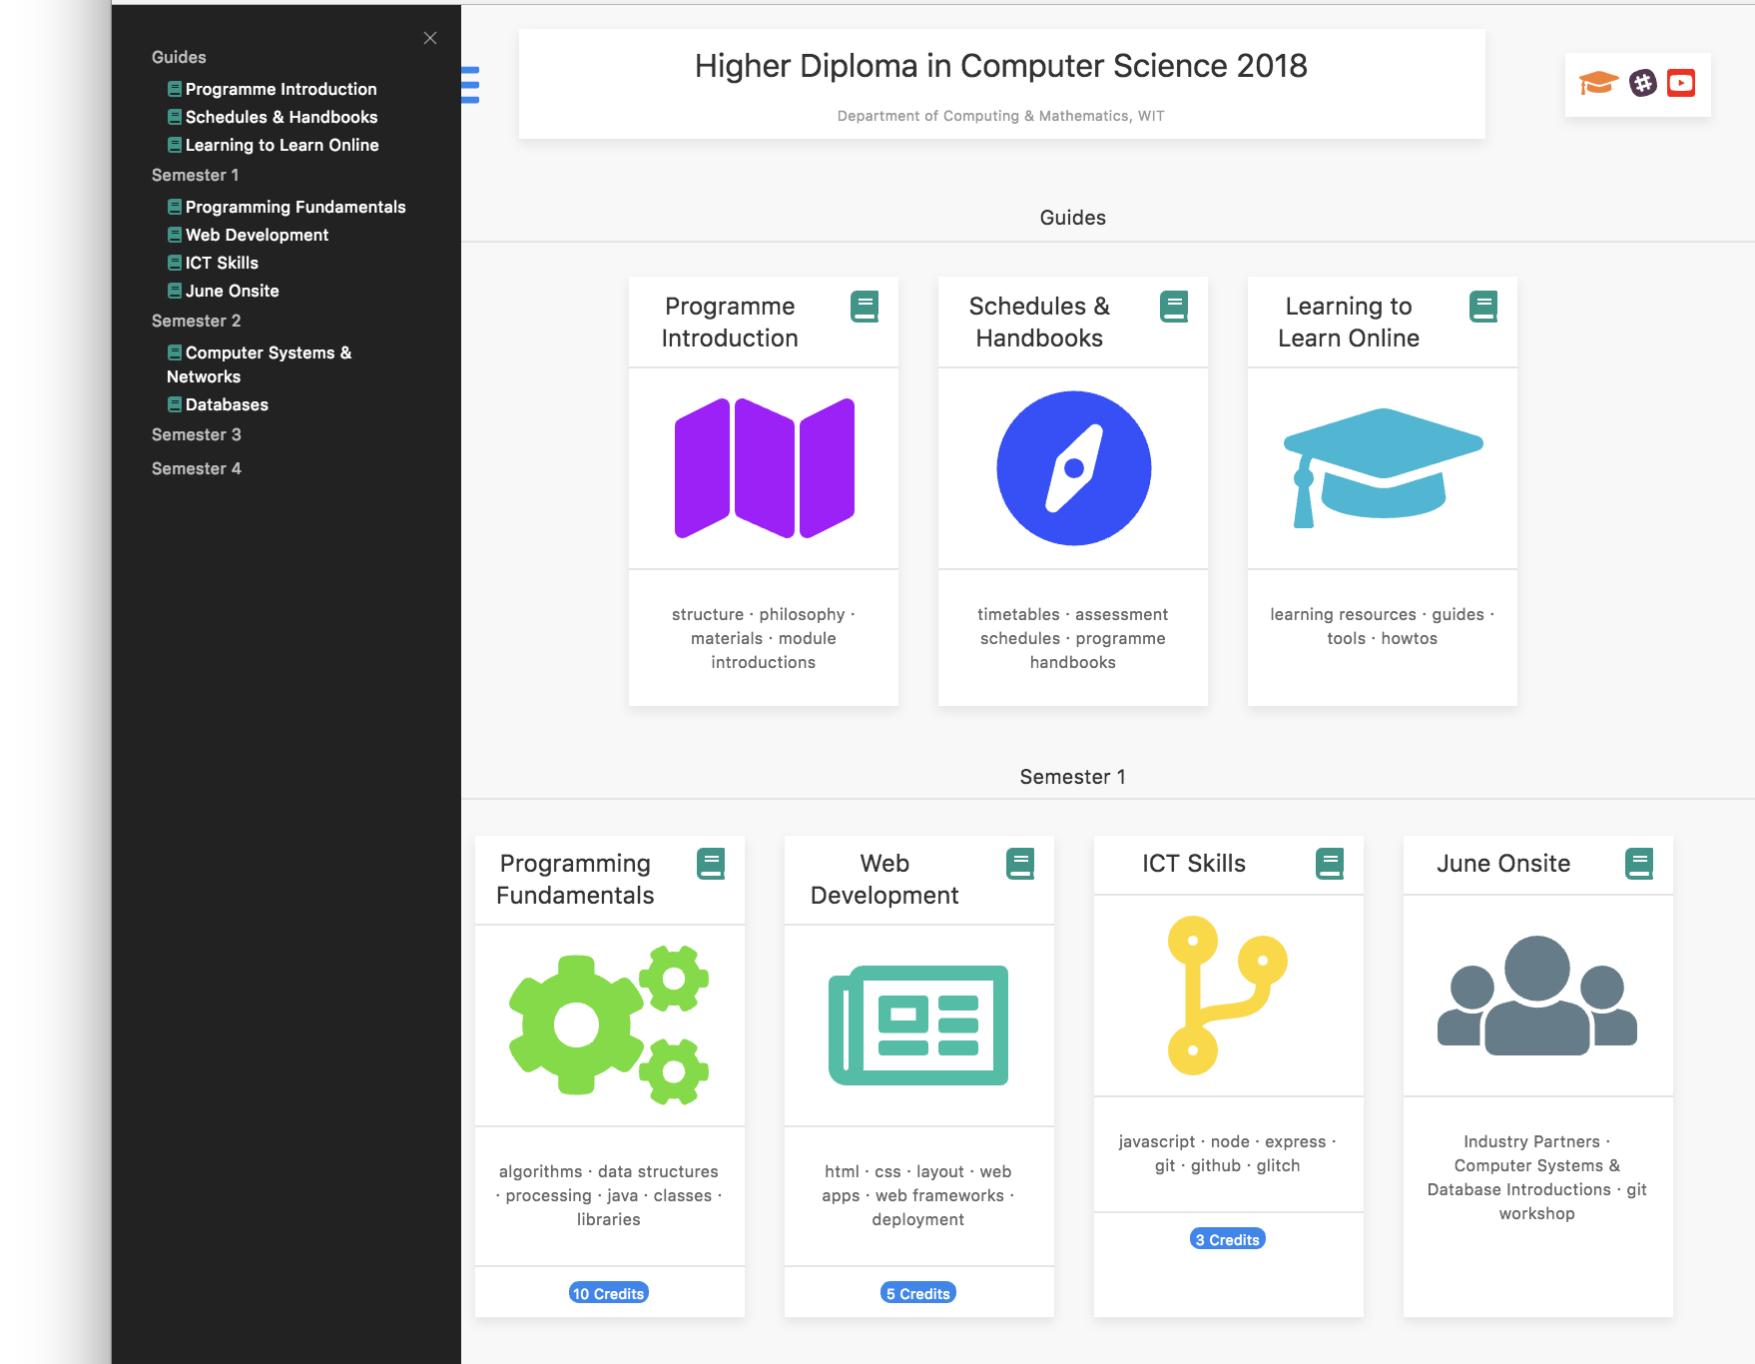
Higher Diploma is Computer Science
Context & Objectives
Online Experience

Slide 3
Higher Diploma is Computer Science 2013-2017
Launched in 2013 in Traditional Mode Initial focus on upskilling unemployed candidates
12 month Tuition + 6 months work placement
Specific focus on Modern Software Developer Skill Set
Approx. 70 graduates over 2012-2018 – majority now working in Technology sector in South East & Nationally.

Slide 4
Higher Diploma is Computer Science 2018
Programme now completely online – all candidates at work in diverse fields
All candidates must have level 8 Degree
24 months part time, including 6 months full time work placement
30 students enrolled in January 2018
50 places approved for January 2019

Slide 5

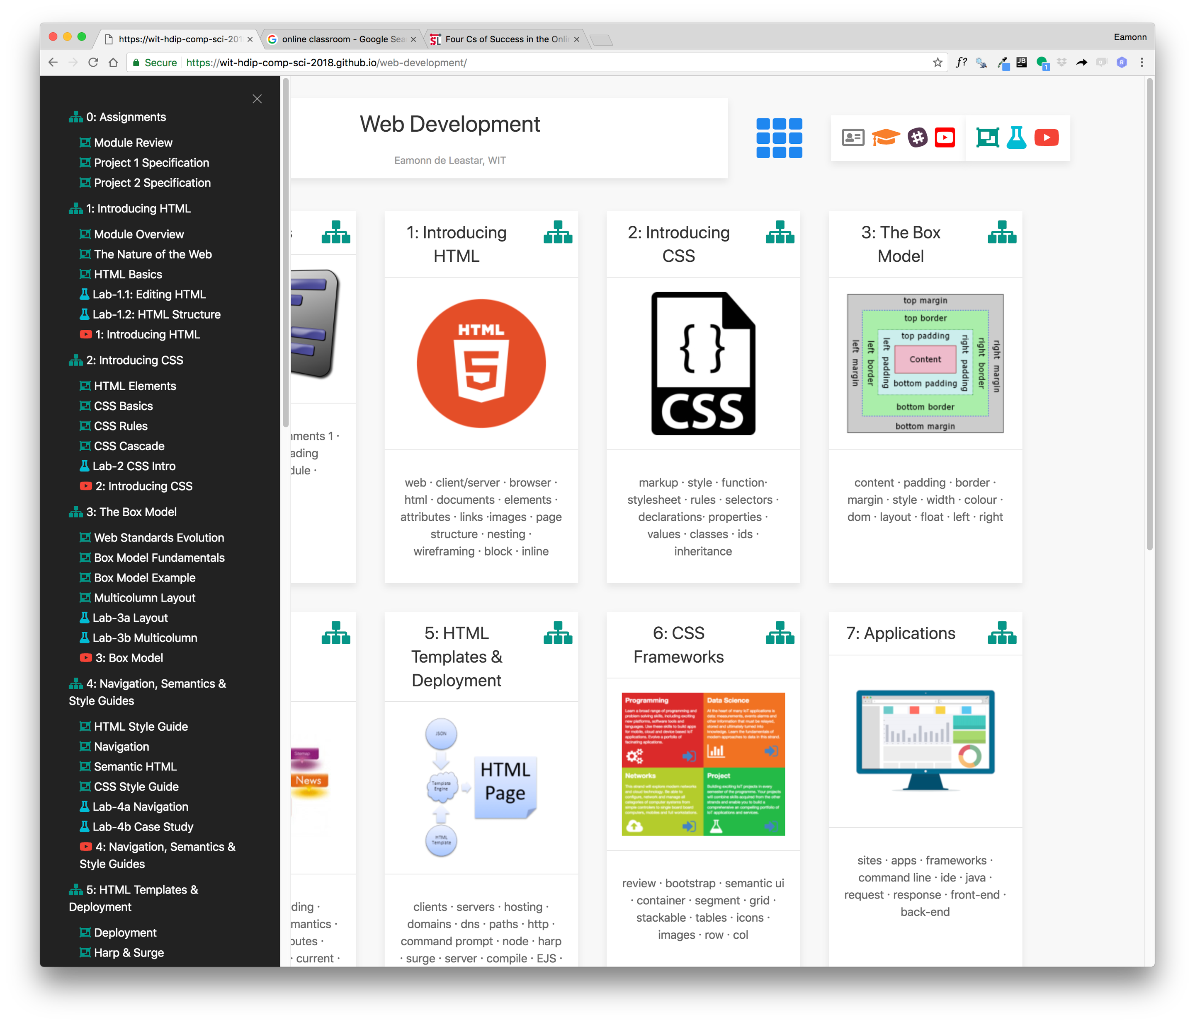
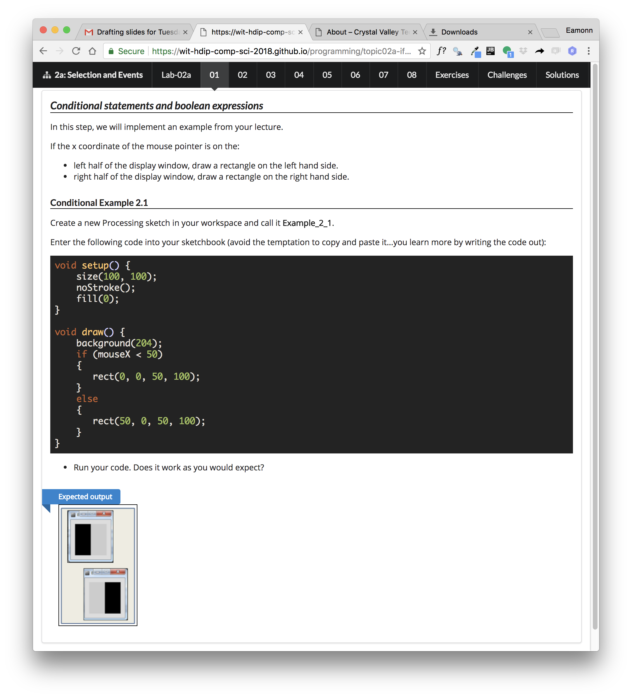
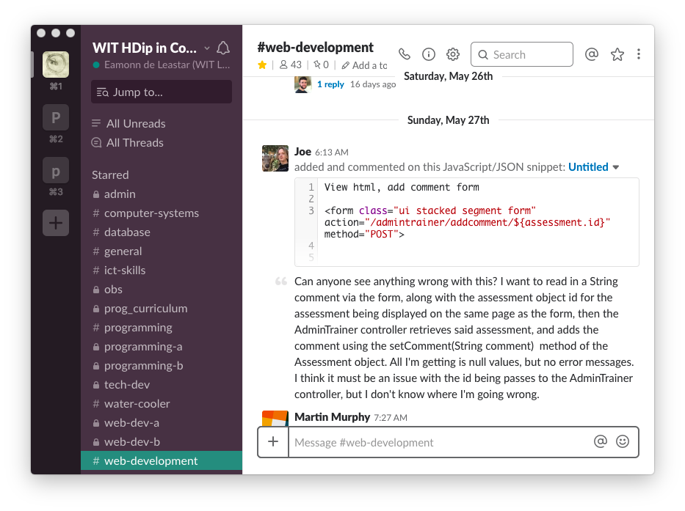
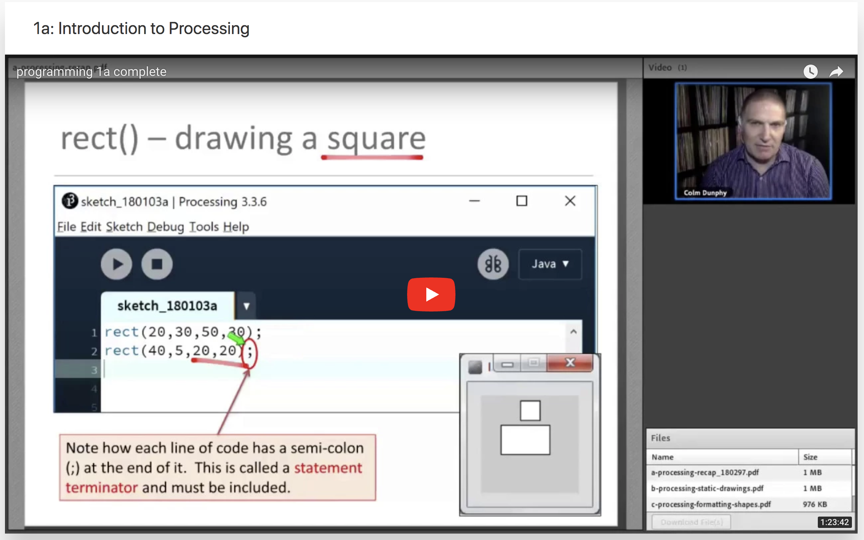
Highest Quality Online Experience
Instructional Resources
Live Webinars
Recorded Lectures
Community Interaction
Assessment & Feedback
Onsite Sessions

Slide 6
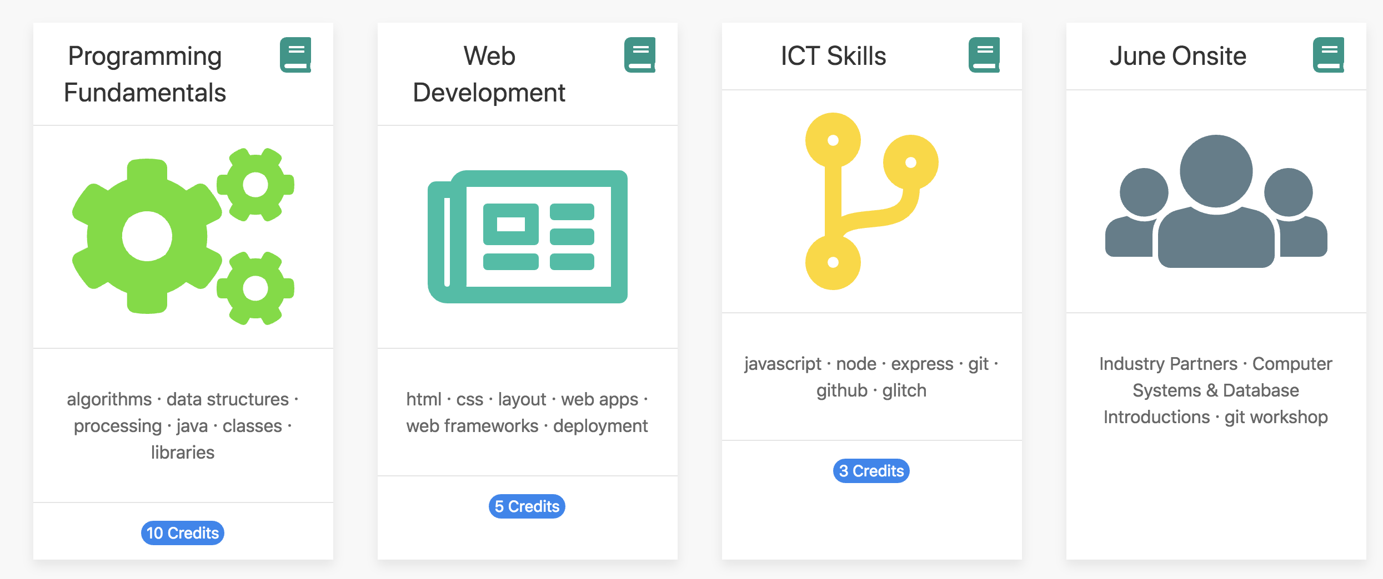
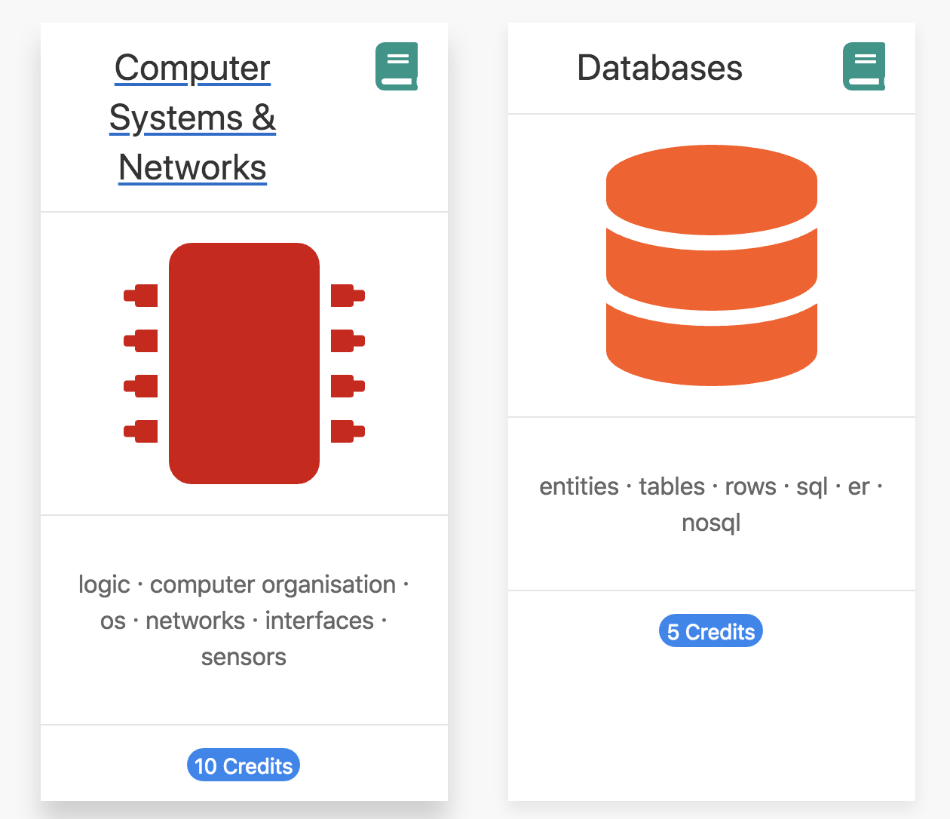
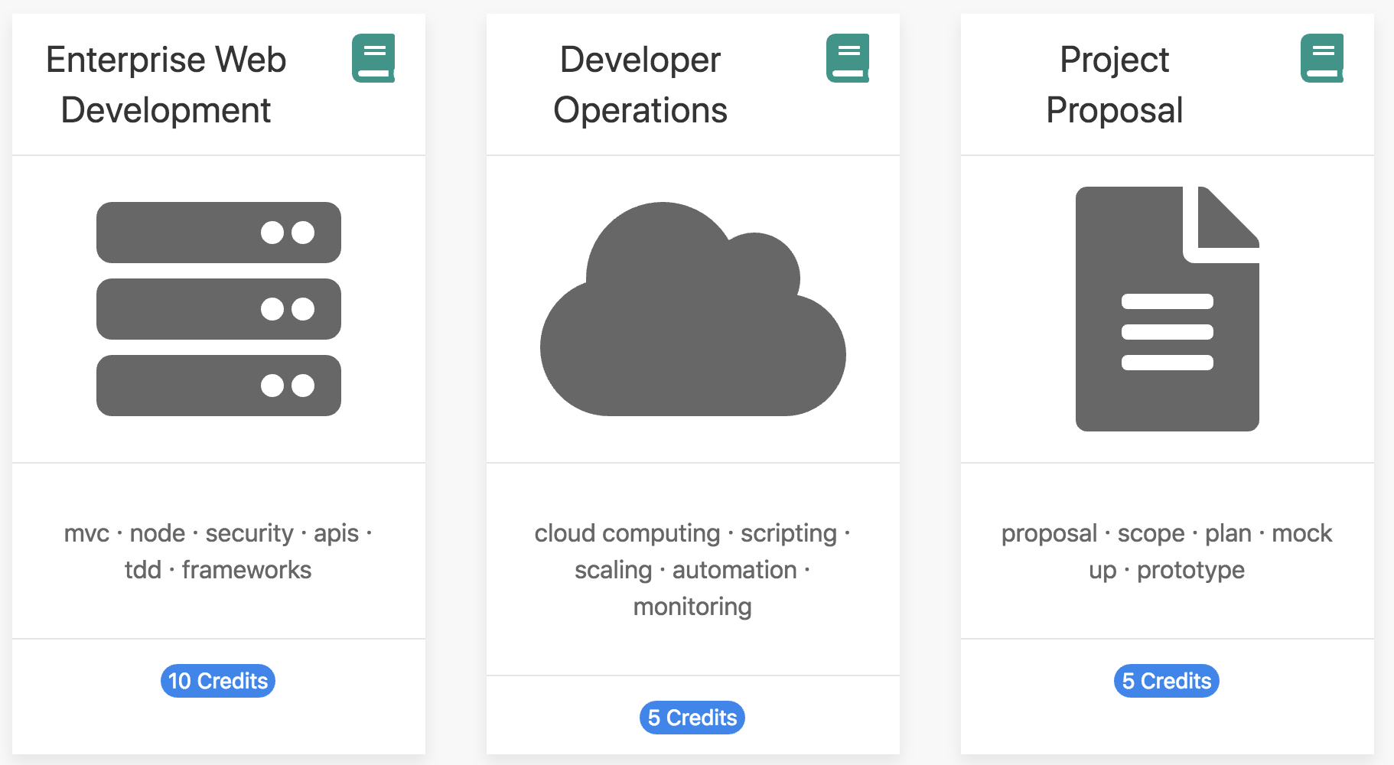
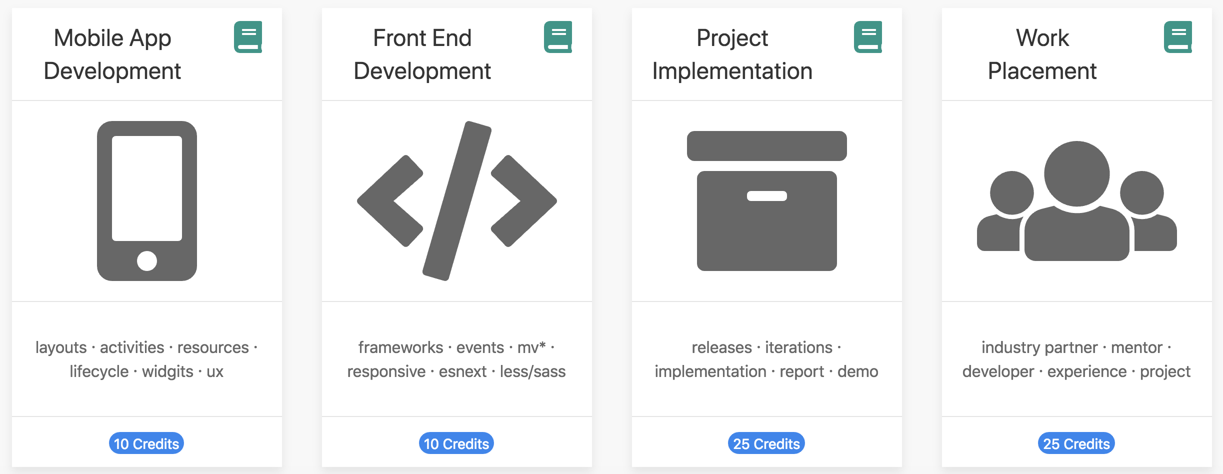
Programme Structure
Semester 1
Semester 2
Semester 3
Semester 4

Slide 7
Open Course Portal
wit-hdip-comp-sci.github.io
wit-hdip-comp-sci-2018.github.io

Slide 8
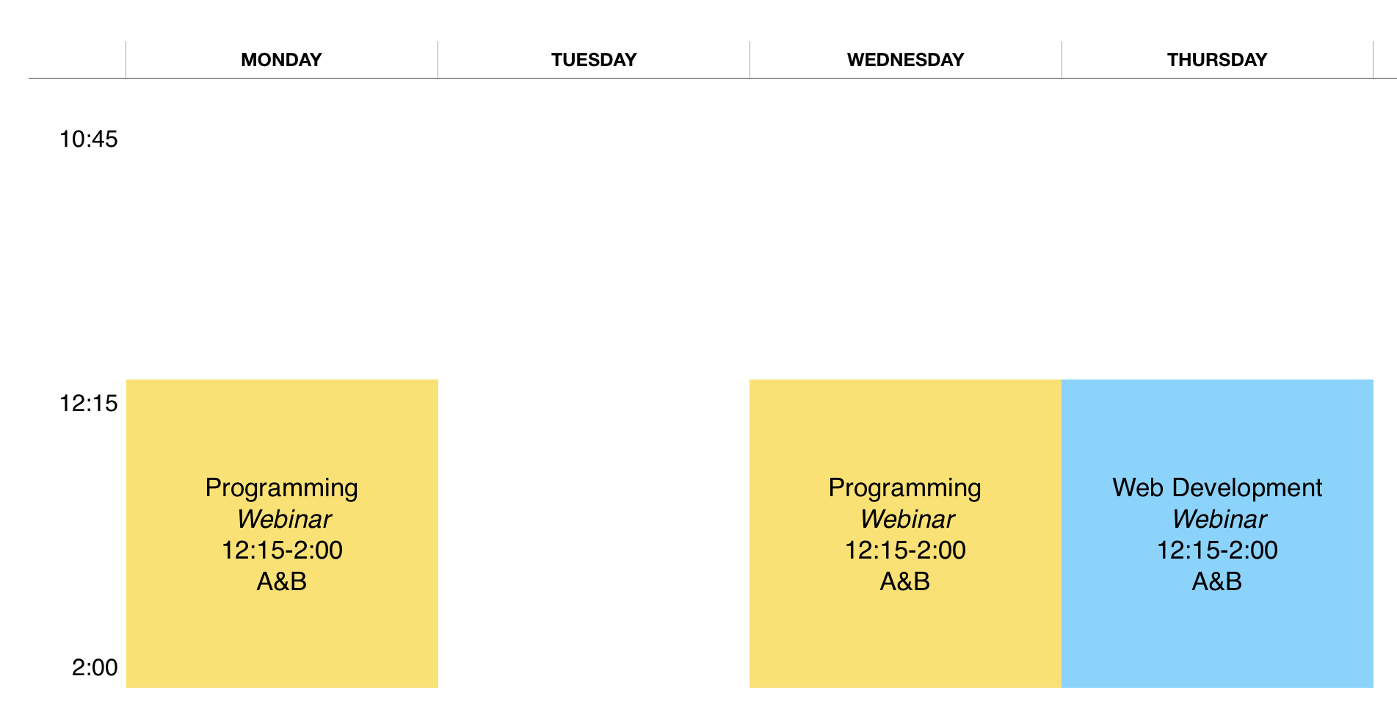
Weekly Timetable
Weekly Webinars
+ Self Directed Labs
+ Slack Channels

Slide 9
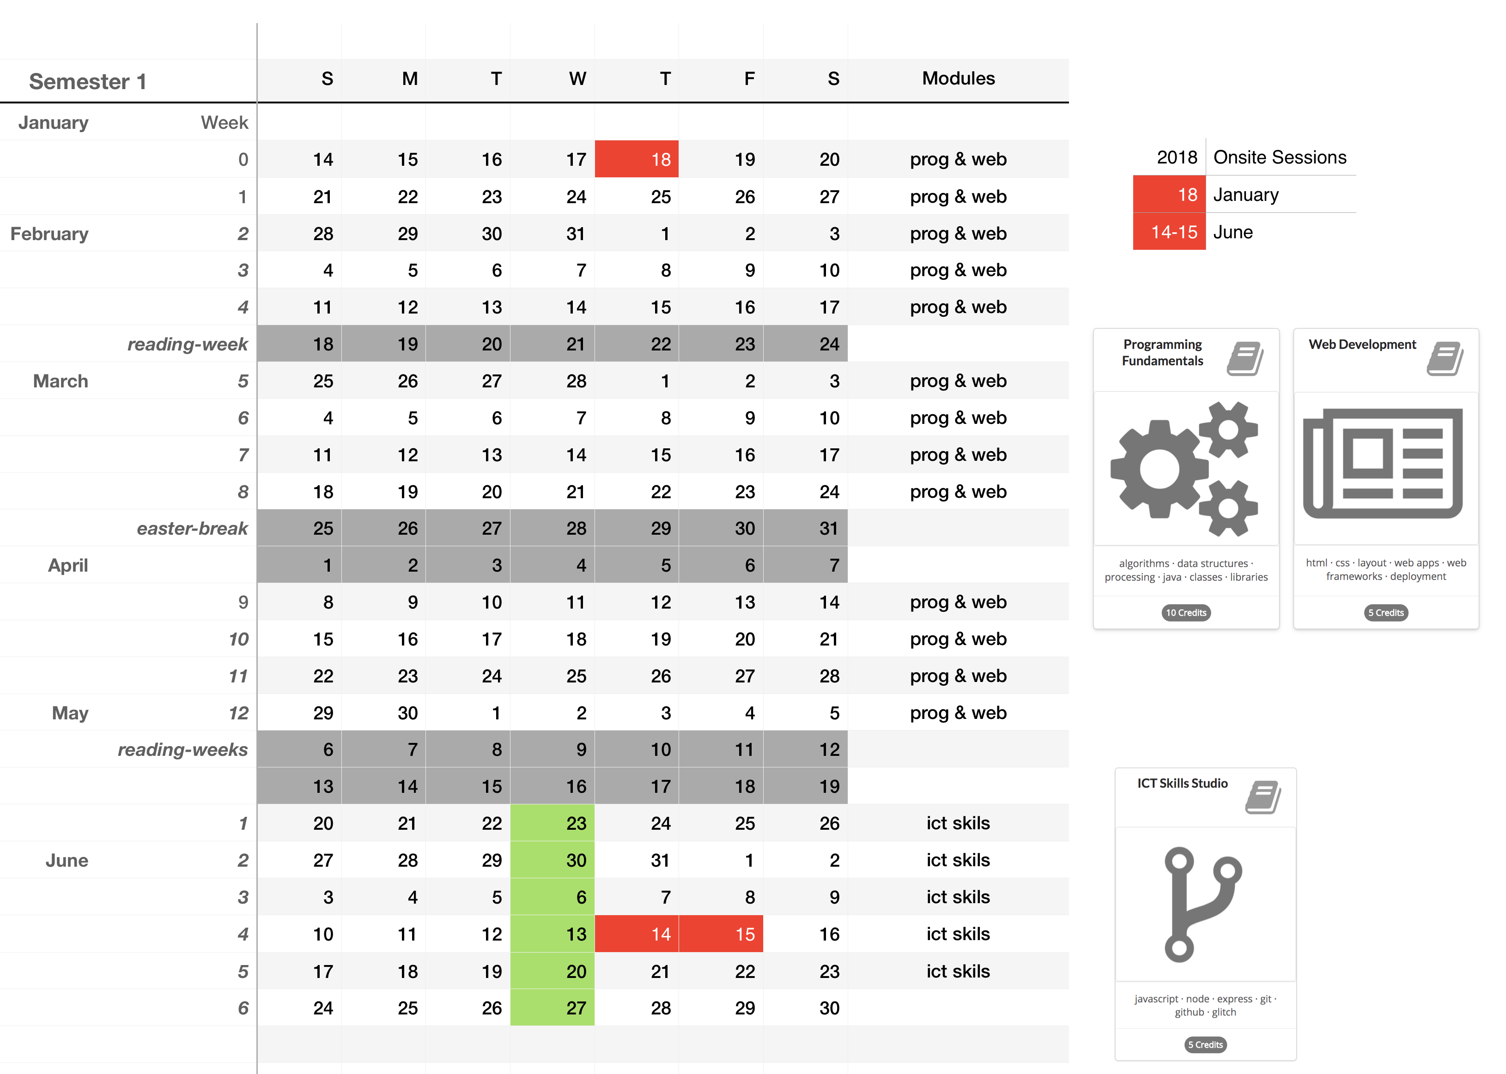
Module Calendar

Slide 10
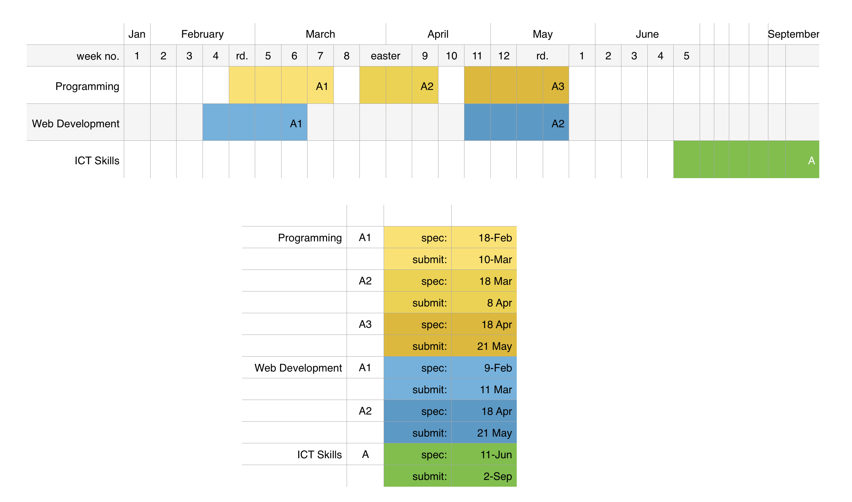
Assessment Calendar

Slide 11

Links to:
Live Webinar
Assessment
Slack
Youtube Channel
Weekly Topics
Module Structure

Slide 12
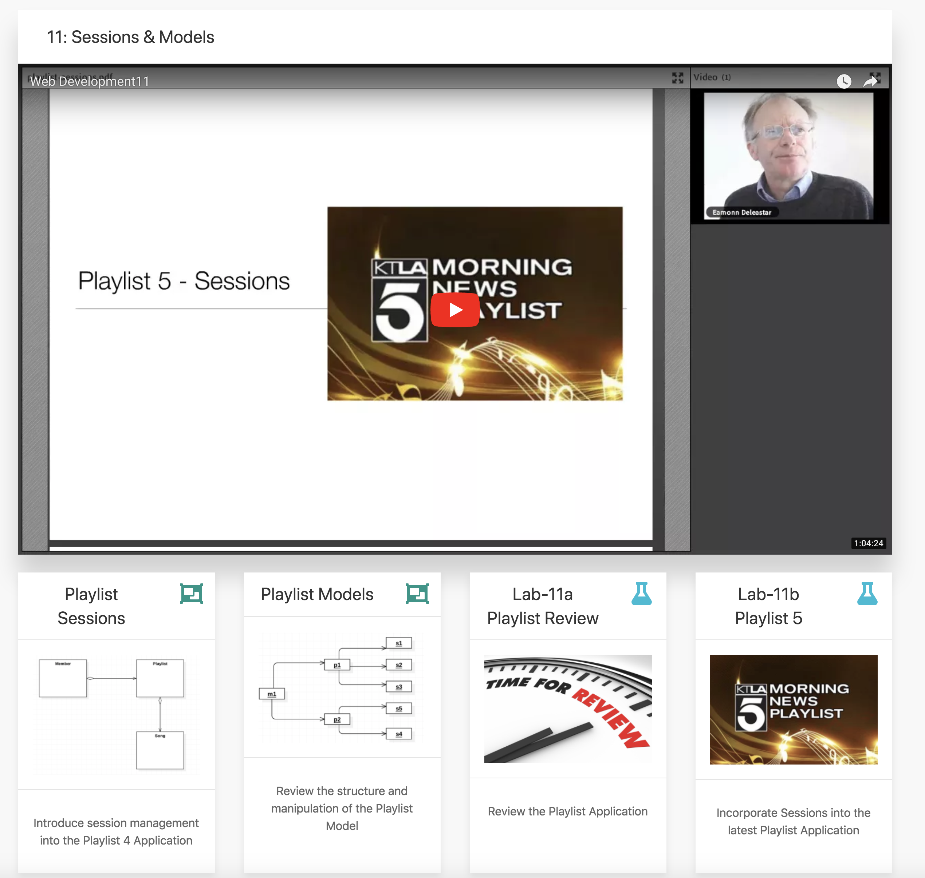
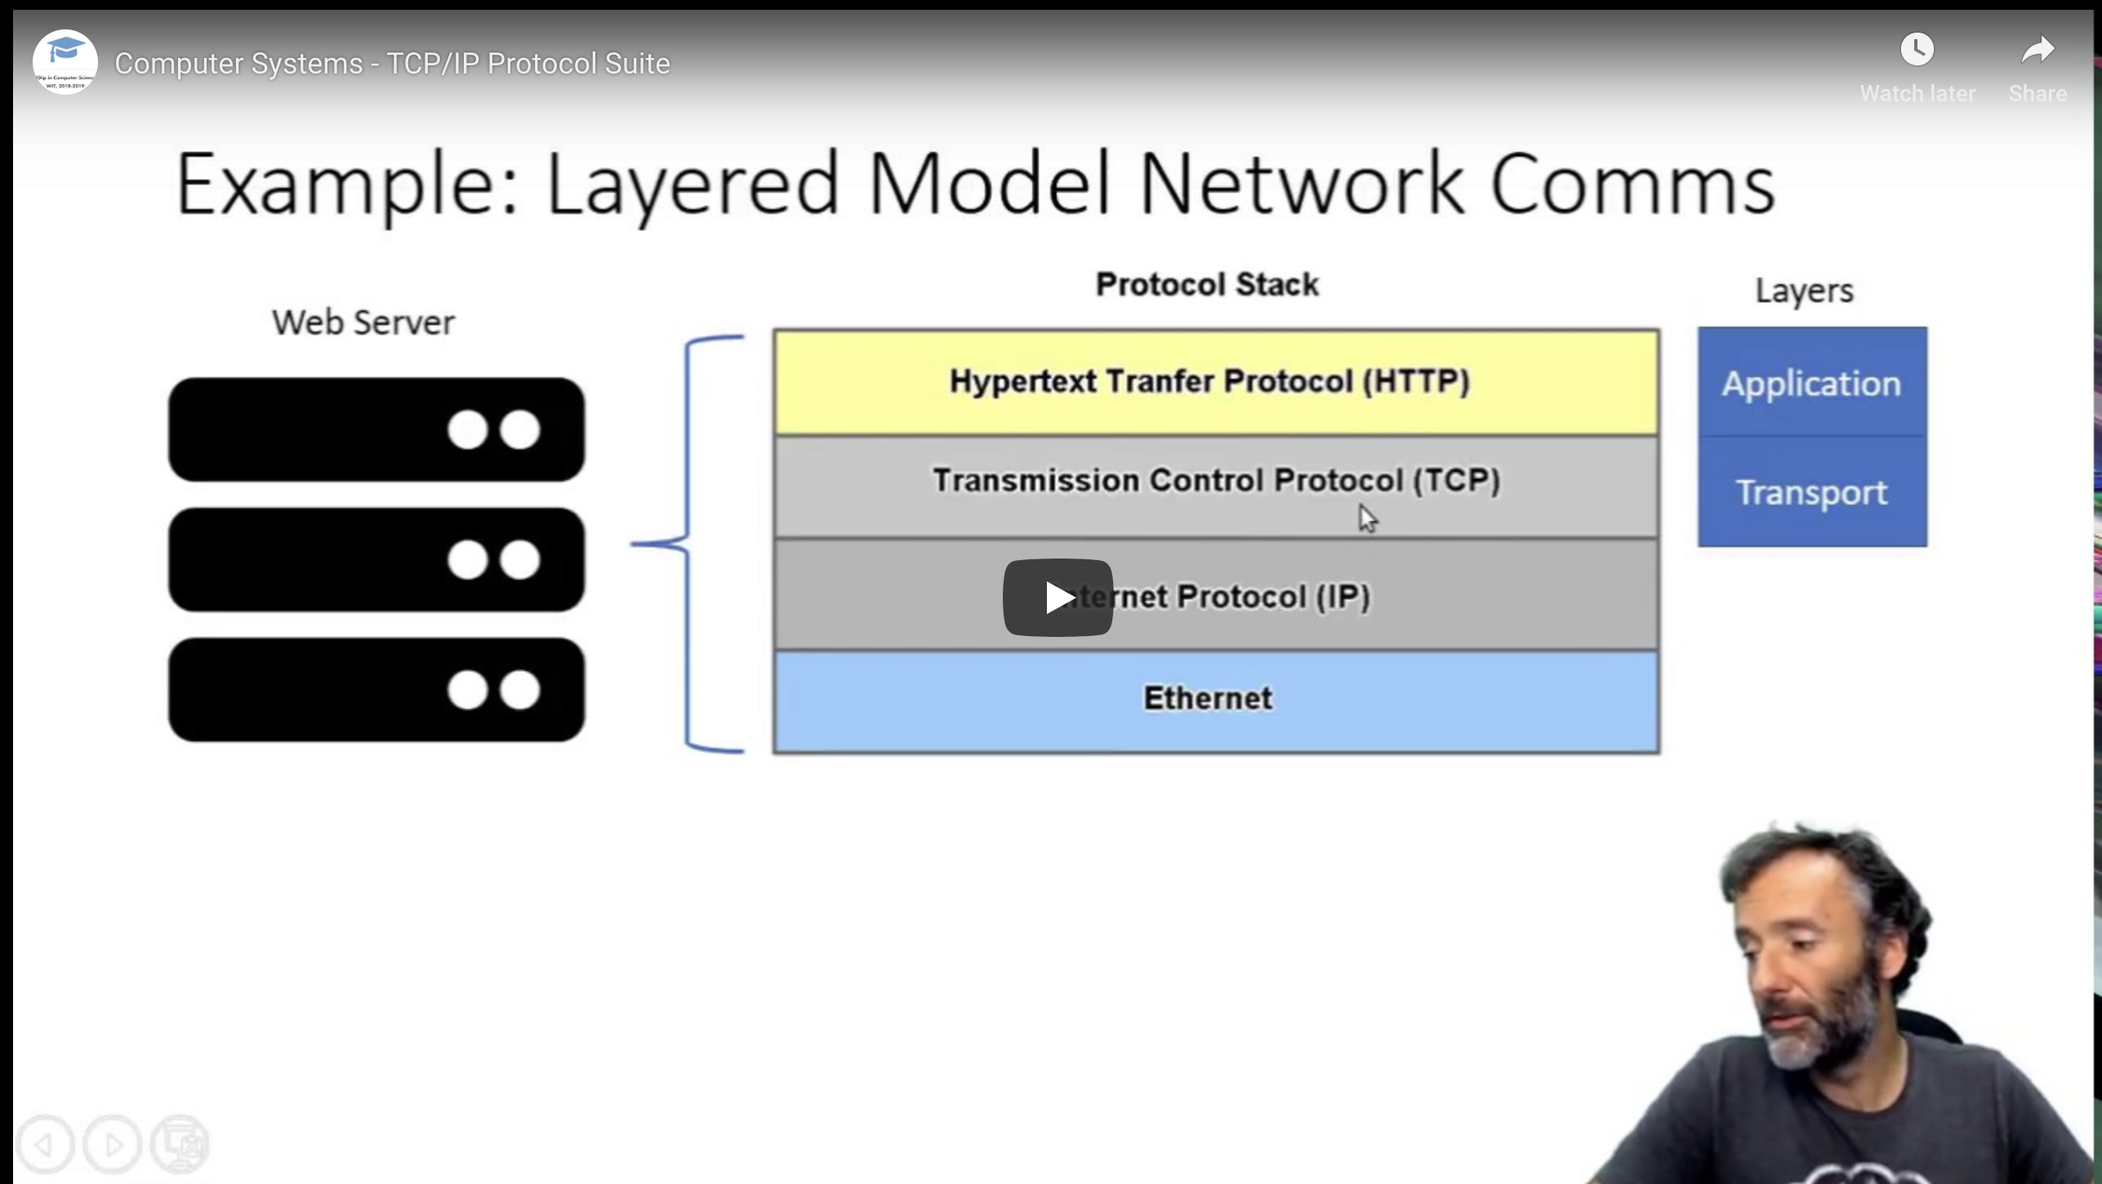
Weekly Video Recording
Slides
Labs
Topic Structure

Slide 13
Self-paced lab steps
Clear, simple instructions
Syntax highlighted code fragments
Illustrations
Lab Structure

Slide 14


Lab Support via
“Leading Messaging & Communication Application for Teams”
ALL communications in one place
One Stop Shop
Fully SEARCHable
Including within documents
Integrates with existing tools
E.g. Google, DropBox, Git
Fosters Collaboration
No More Emails!

Slide 15
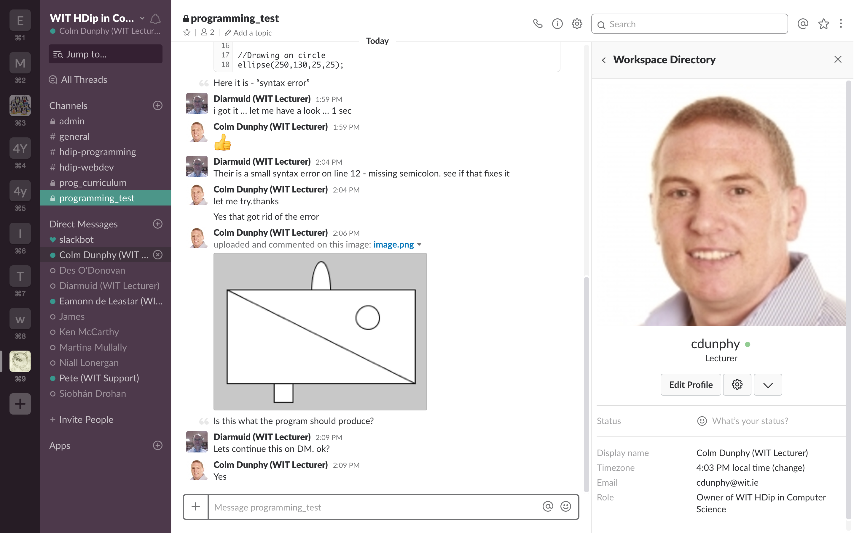
WORKSPACES
CHANNELS
DIRECT
MESSAGES (DM)
TYPE HERE
CLICK TO UPLOAD – files / content

Slide 16
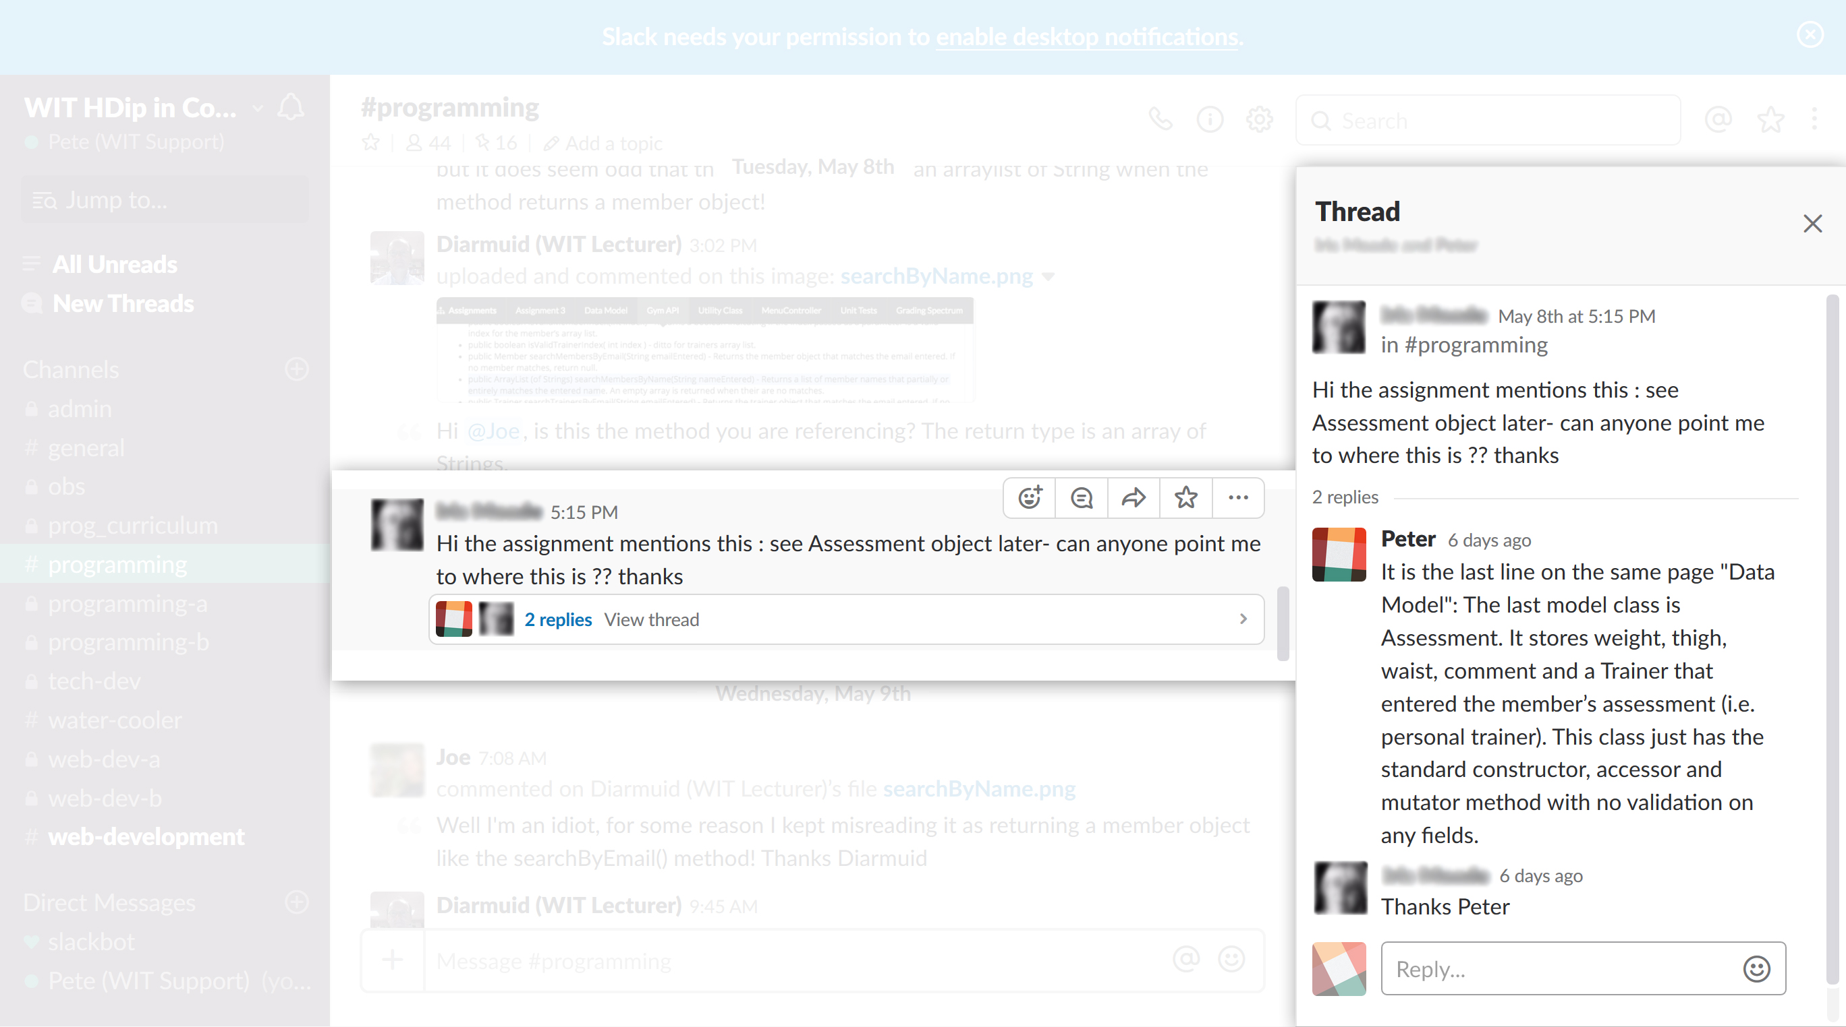
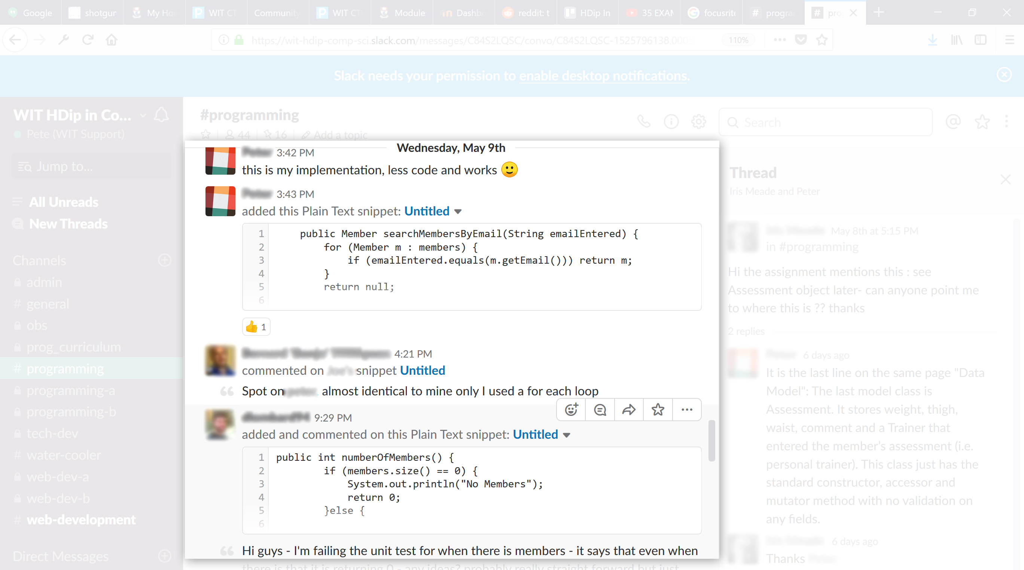
Threads
Peer Support

Slide 17
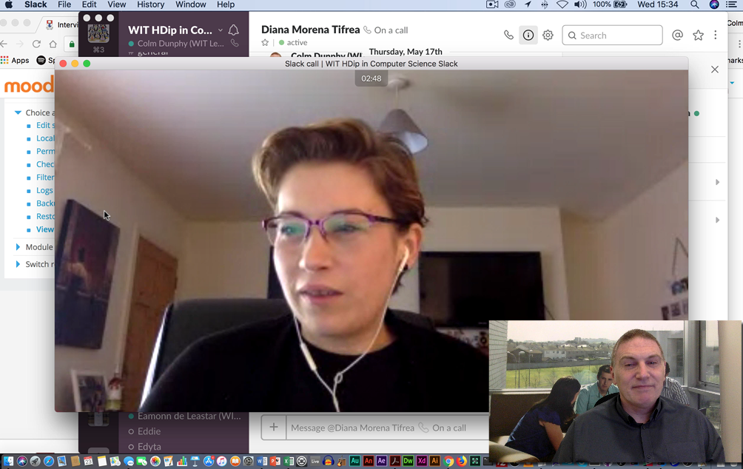
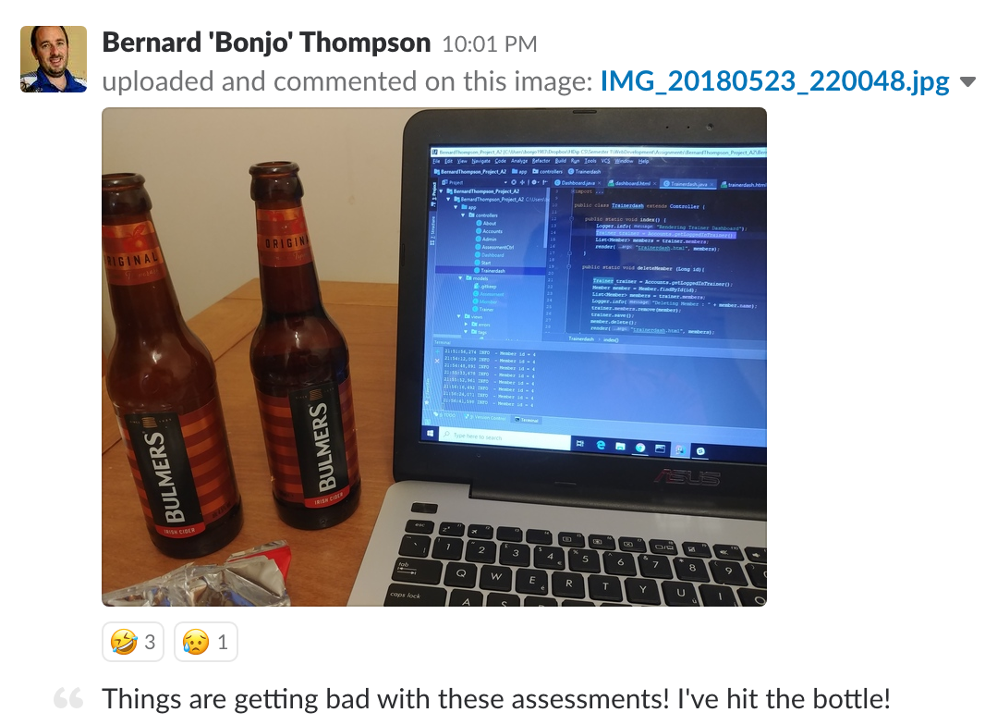


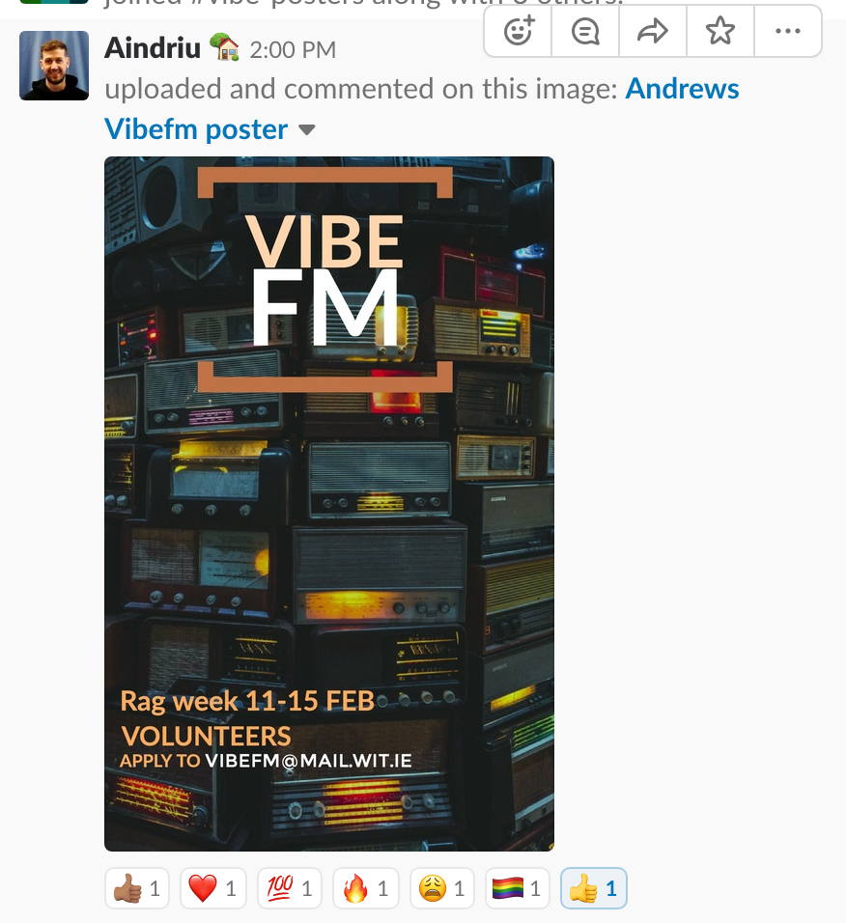
Replicating Social & Community Interactions
Interviews
Water Cooler
Reactions

Slide 18
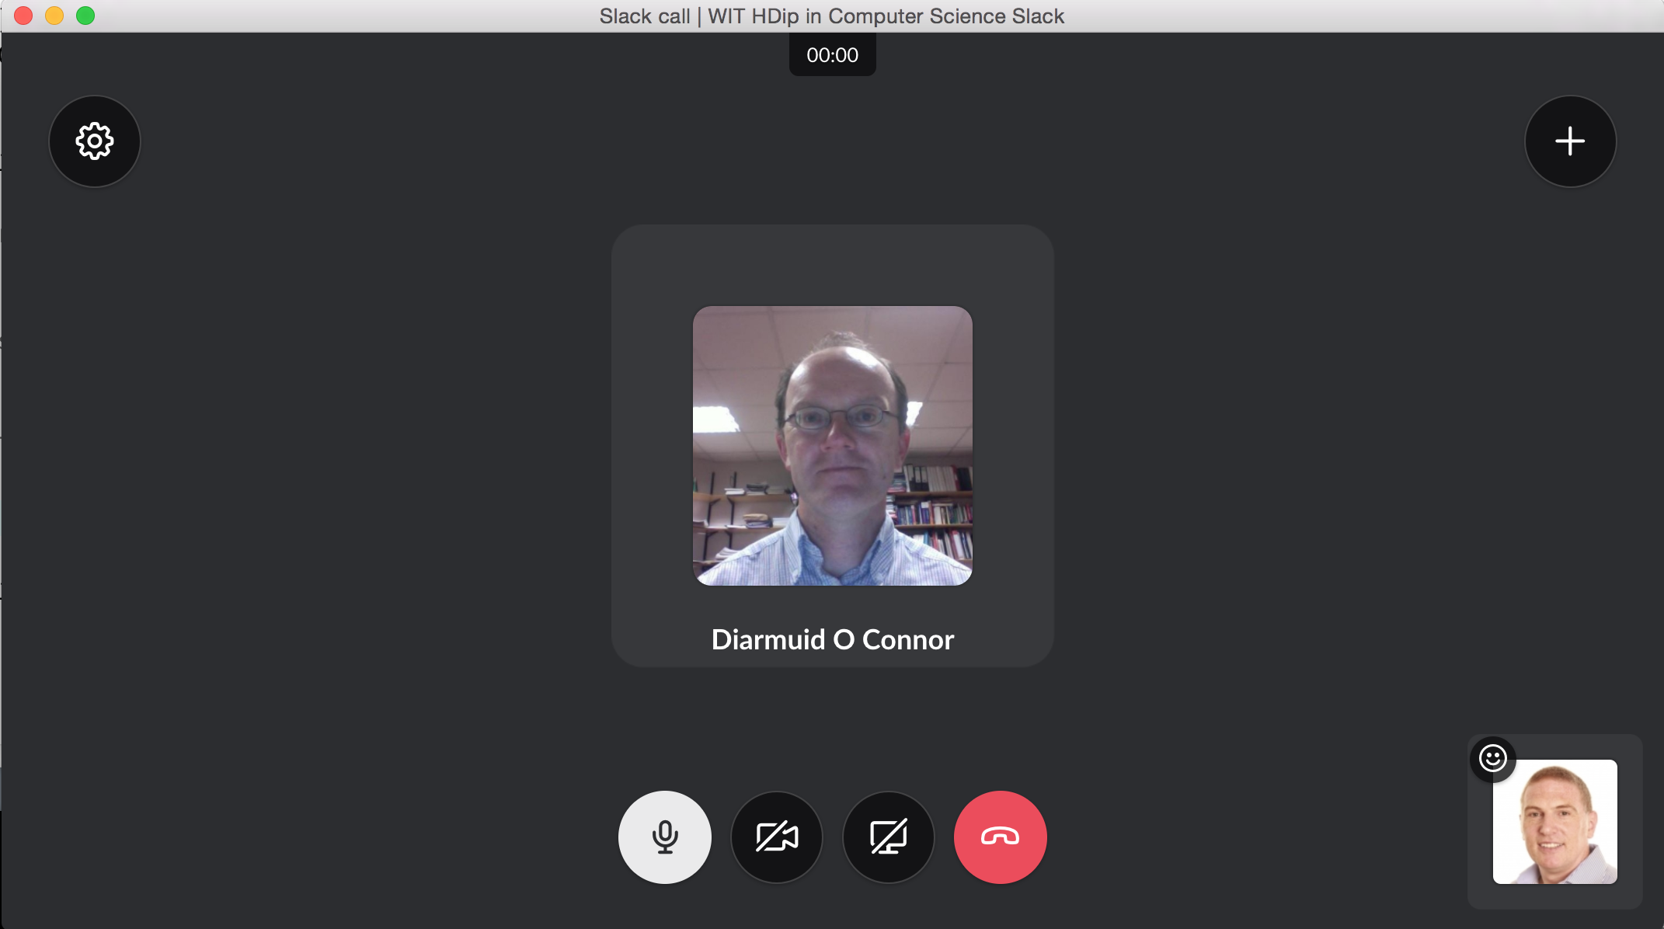
Share
Screen
Video Webcam
Mic
(on by default)
(desktop client only)
Enable others to draw on your screen
Stop
Sharing
Give others Full Control of your computer
Notes:
Used Screen Share in place of adobe connect for live video Support in configuring software Support with code demonstrations and intervies

Slide 19
“For me this course captures the Essence and Ethos of what adult education should be”
“Everything is easily accessible (great website), everyone is so helpful and generous with their knowledge,
it is very refreshing”
“The course is clear, precise,
exceptionally well laid out and so professionally run”
“Everything is easily accessible (great website), everyone is so helpful and generous with their knowledge,
it is very refreshing”
“All the options available to play back, notes etc. really have enhanced my learning experience…”

Slide 20
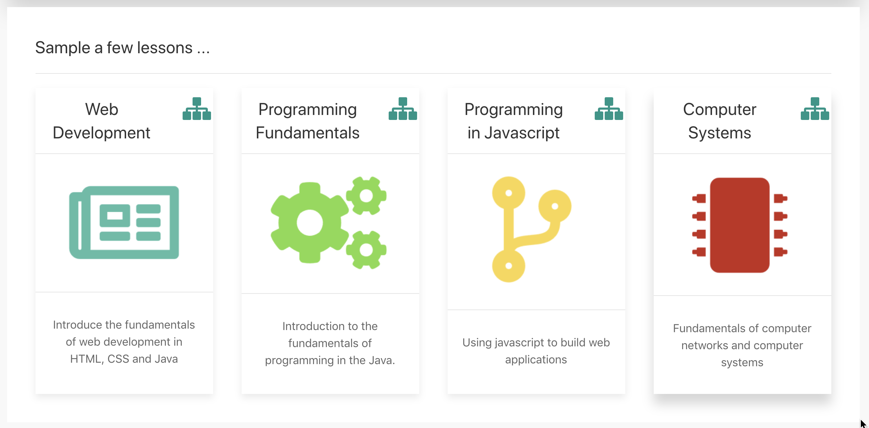

Slide 21
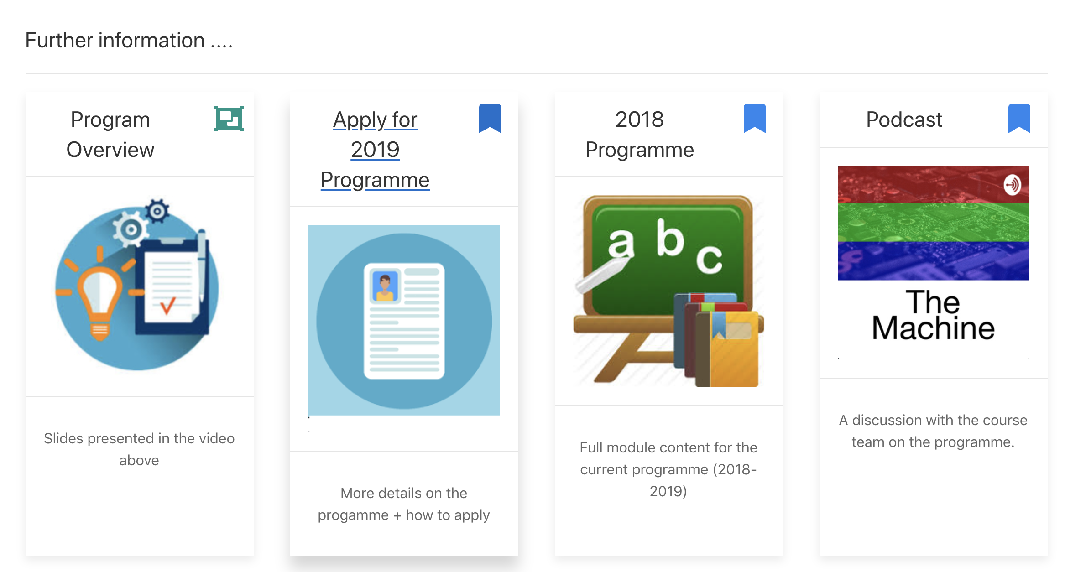

Slide 22
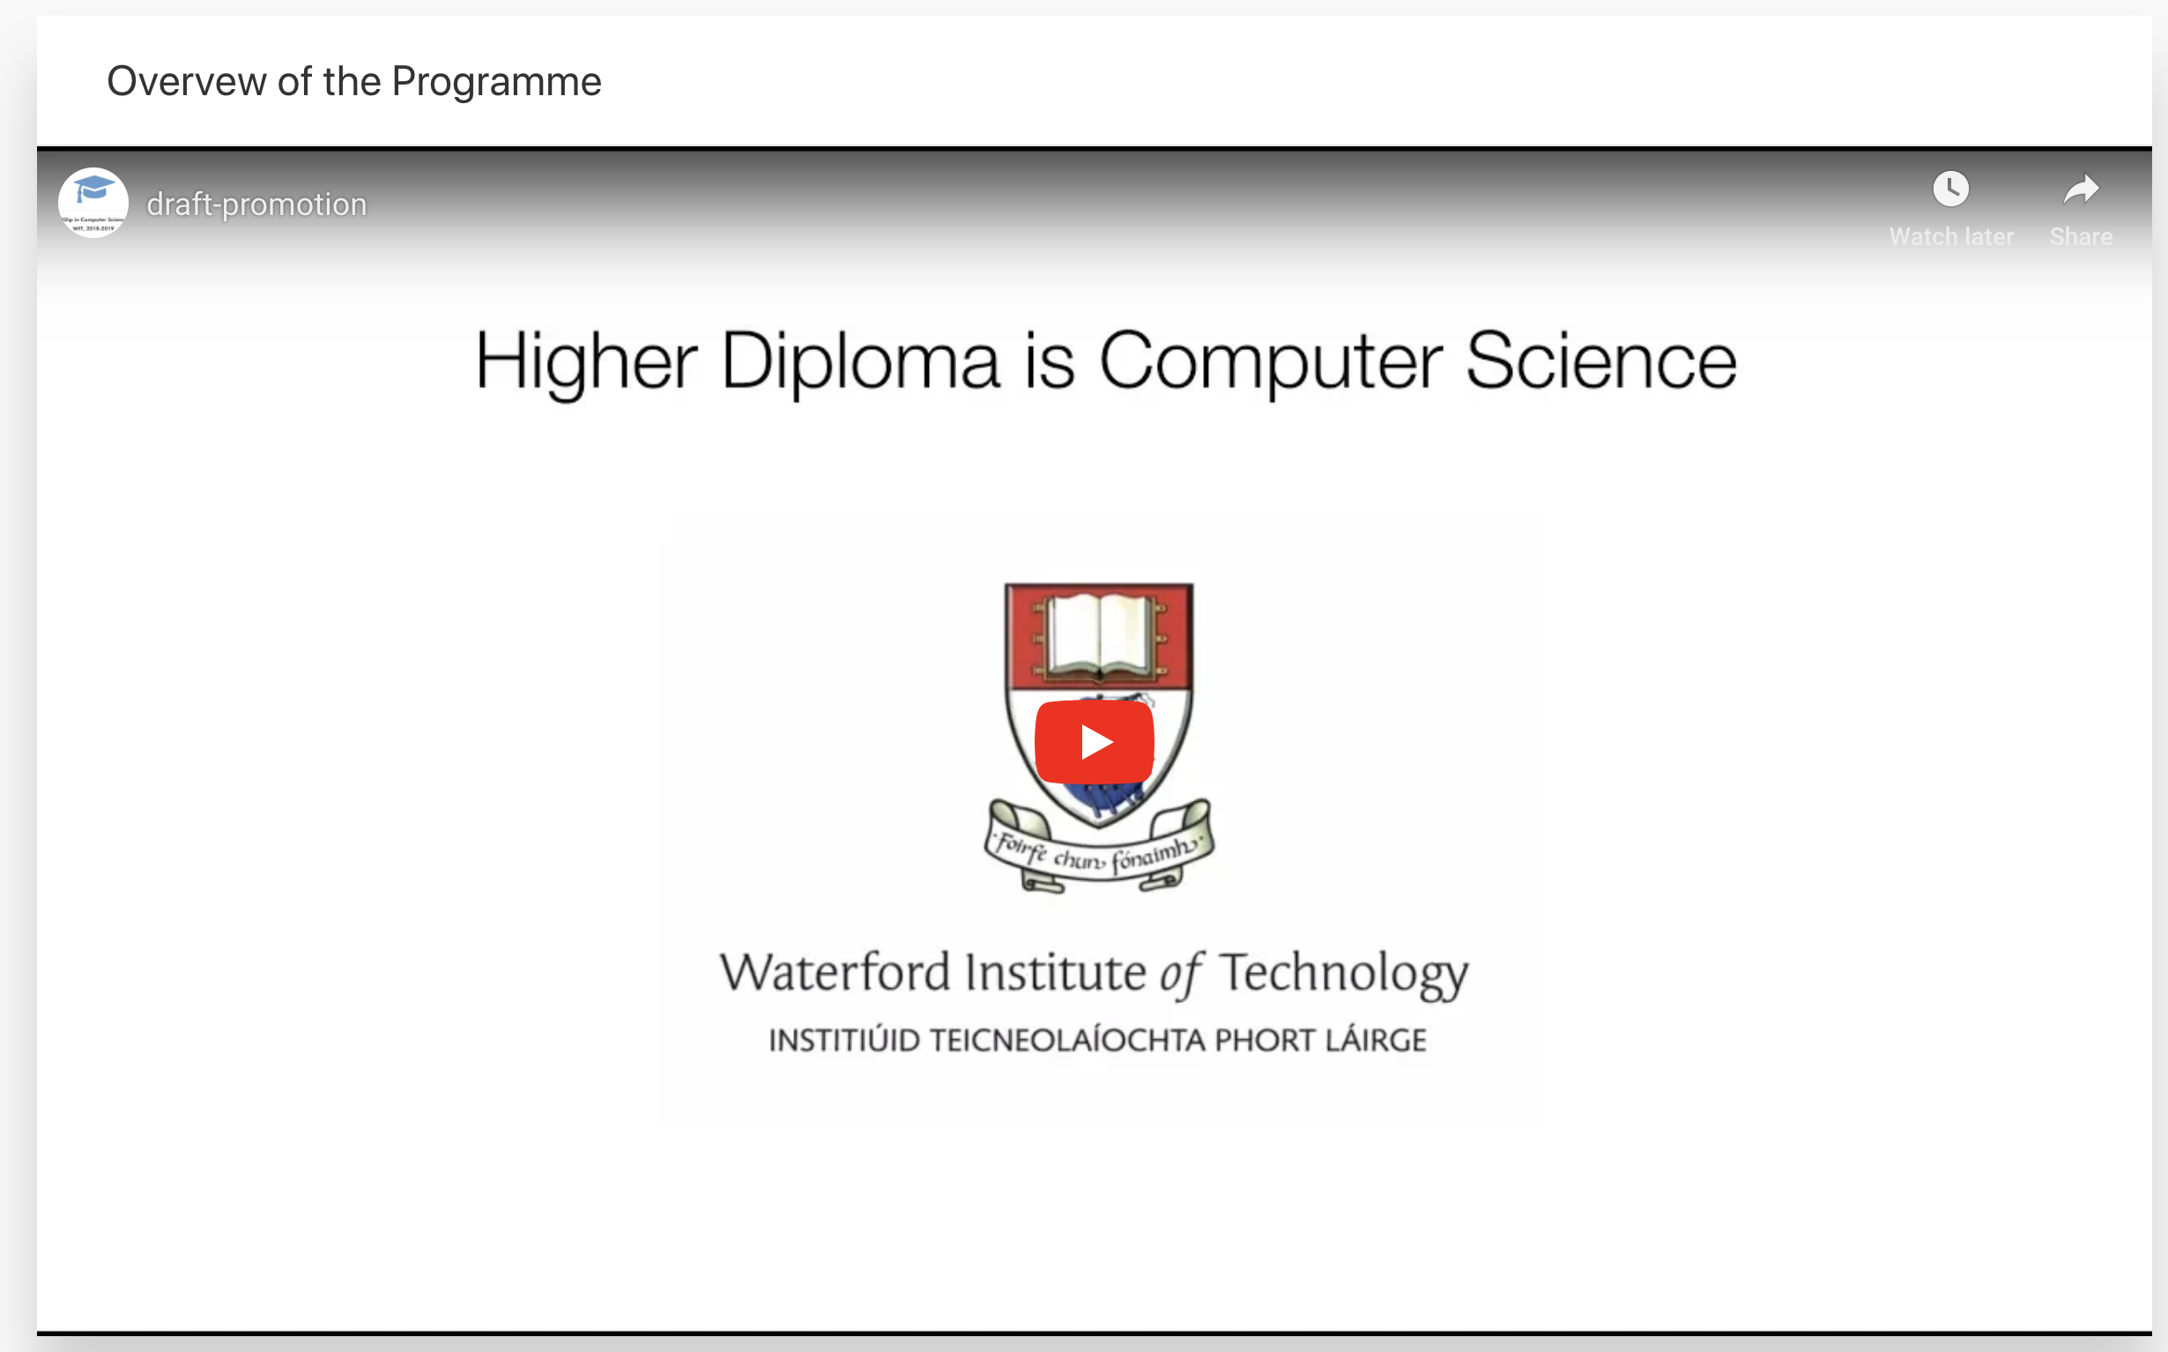
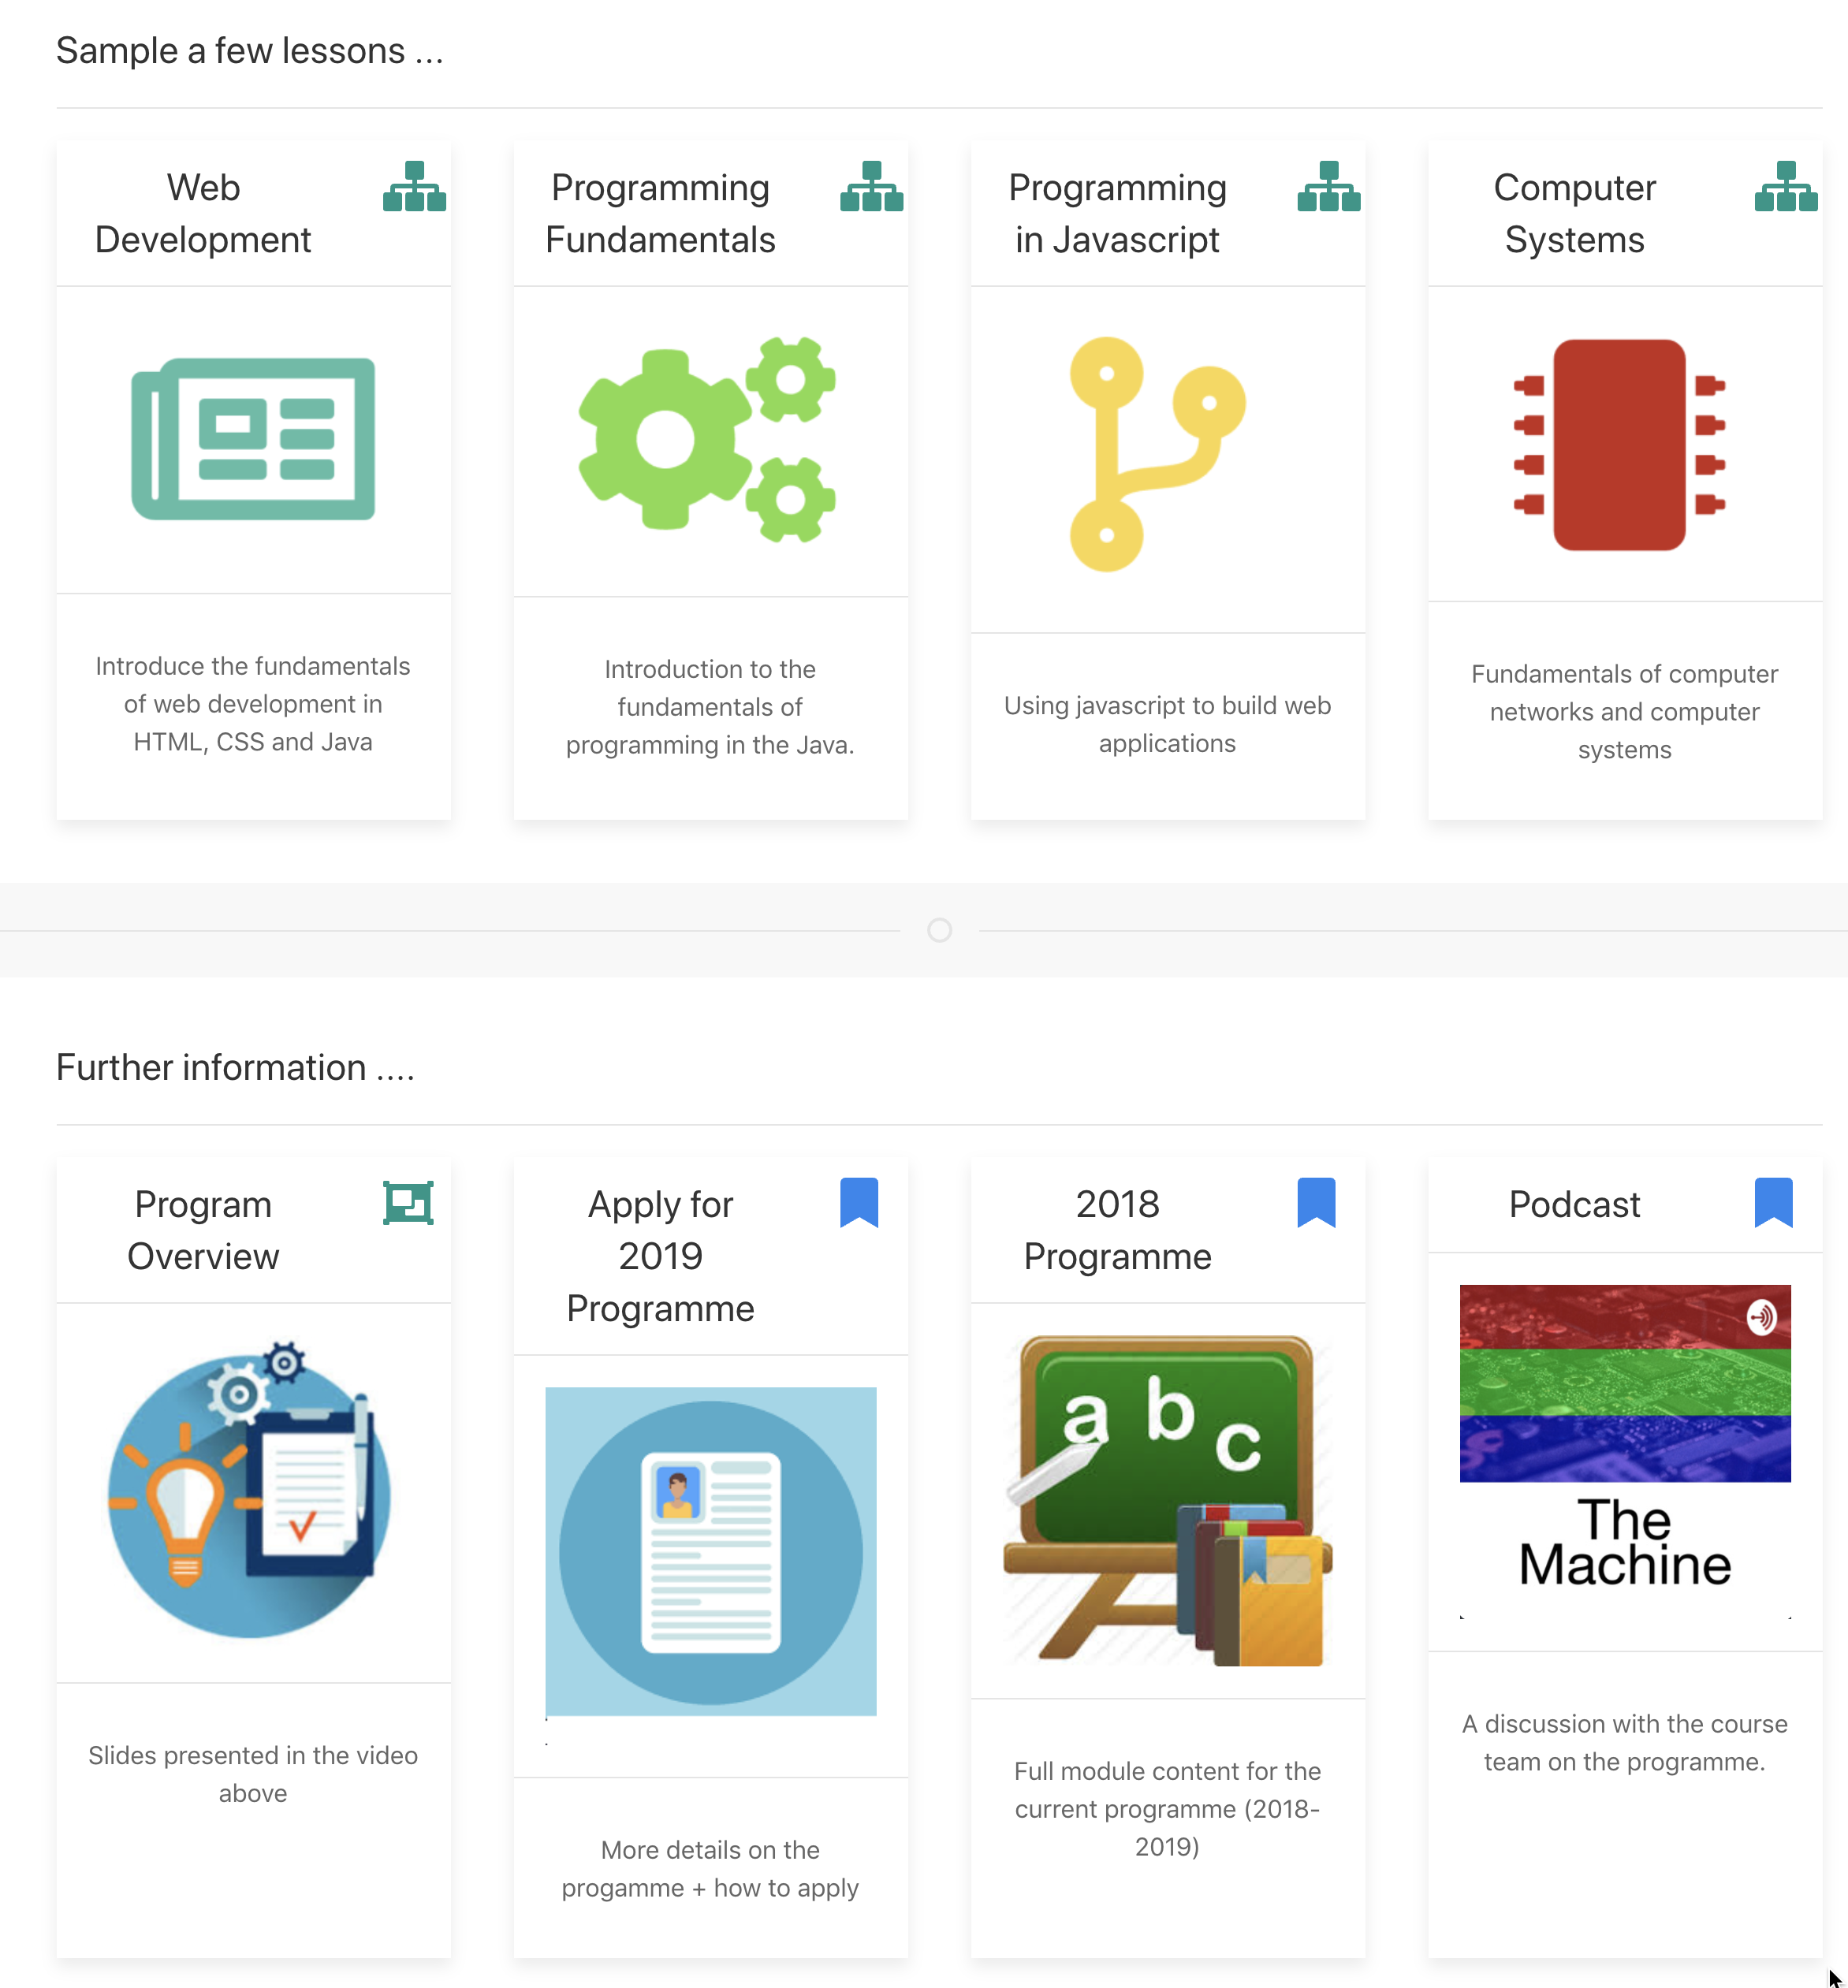
edeleastar@wit.ie
jmangan@wit.ie
https://wit-hdip-comp-sci.github.io

